Slide 1
Time Series Components &
Hodrick-Prescott Filter
Renato R. Maaliw III, DIT
College of Engineering
Southern Luzon State University
Lucban, Quezon, Philippines

Slide 2
Trends
represents long-term, gradual movement of time series (TS)
indicates whether the data is increasing, decreasing, or stable over time

Slide 3
Trends (Examples)
1. Stock market index: Long-term upward trend due to economic growth
2. Global temperature: Upward trend due to climate change
3. E-Commerce sales: Increasing trend due to digital adoption

Slide 4
Seasonality
refers to regular, predictable patterns in a TS that occur at fixed intervals (daily, weekly, monthly, yearly)

Slide 5
Seasonality (Key Characteristics)
1. Fixed, known intervals (e.g. every 12 months)
2. Short-term fluctuations that repeat periodically

Slide 6
Seasonality (Examples)
1. Retail sales: Higher in December due to Christmas season
2. Electricity demand: Peaks in summer and winter
3. Tourism industry: More visitors in summer, fewer in winter

Slide 7
Cyclical Patterns
refers to long-term, irregular fluctuations that do not follow a fixed schedule
larger time scale (years to decades)

Slide 8
Cyclical Patterns (Key Characteristics)
1. No fixed period, it varies in length
2. Influenced by external factors (economy, crises, policies)
3. Can be seen often in business cycle analysis or decomposition methods

Slide 9
Cyclical Pattern (Examples)
1. Stock market cycles: Bull and bear markets
2. Economic recession: Boom and bust cycles
3. Real estate market: Housing price cycles

Slide 10
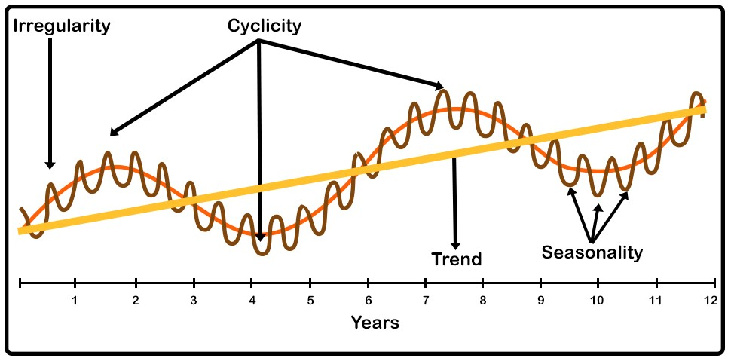

Slide 11
Hodrick-Presscot Filter (HP Filter)
The HP filter is a mathematical tool used in time series analysis to separate a time series into its trend and cyclical components.

Slide 12
Hodrick-Presscot Filter (HP Filter) Usage:
Extract the long-term trend from a TS by smoothing out short-term fluctuations
Isolate the cyclical component to analyze deviations from the trend
Provide a flexible method for decomposing time series without requiring predefined models

Slide 13
[Code Demo]

Slide 14
Thank you very much for listening.

